Slide 1

Simple Personal Finance Models Lecture 15
BSEN 5250/6250
Deterministic Modeling for Biosystems

Slide 2
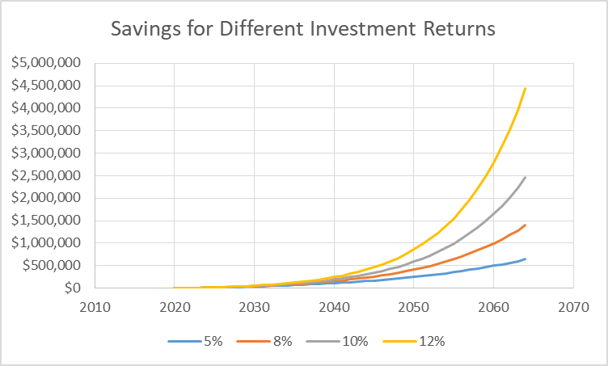
The Value of Money Grows Over Time
If $1,000 is invested for 1 year at an interest rate of 5%, what is the value of the investment at the end of a year?
Year 1 - $1,000 * (1+.05) = $1,050
Year 2 - $1,050 * (1+.05) = $1,103
Year 3 - $1,103 * (1+.05) = $1,158
Increase due to interest
Time is your best friend for wealth accumulation!

Slide 3
Money Balance Equation (Euler Integration)
Savings
V^{t+dt} = V^{t} + (gains – losses) dt
Interest Rate
Where
V = value, $
Gains = rate of increase during time step, $
Losses = expenditures during time step, $
Value, $
Expenditures, $
State variable is the Value of money!

Slide 4
Net Worth Calculation
Net Worth = value of assets – value of liabilities
Assets
Savings & investments
Retirement accounts
Primary home
Real estate
Permanent life insurance
Automobiles
Liabilities
Consumer debt
Personal loans
Student loans
Mortgages
Auto loans
Other debt

Slide 5
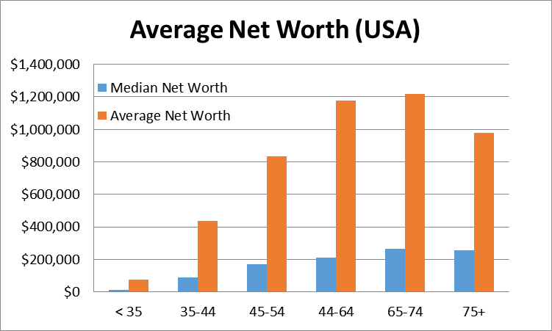

Slide 6
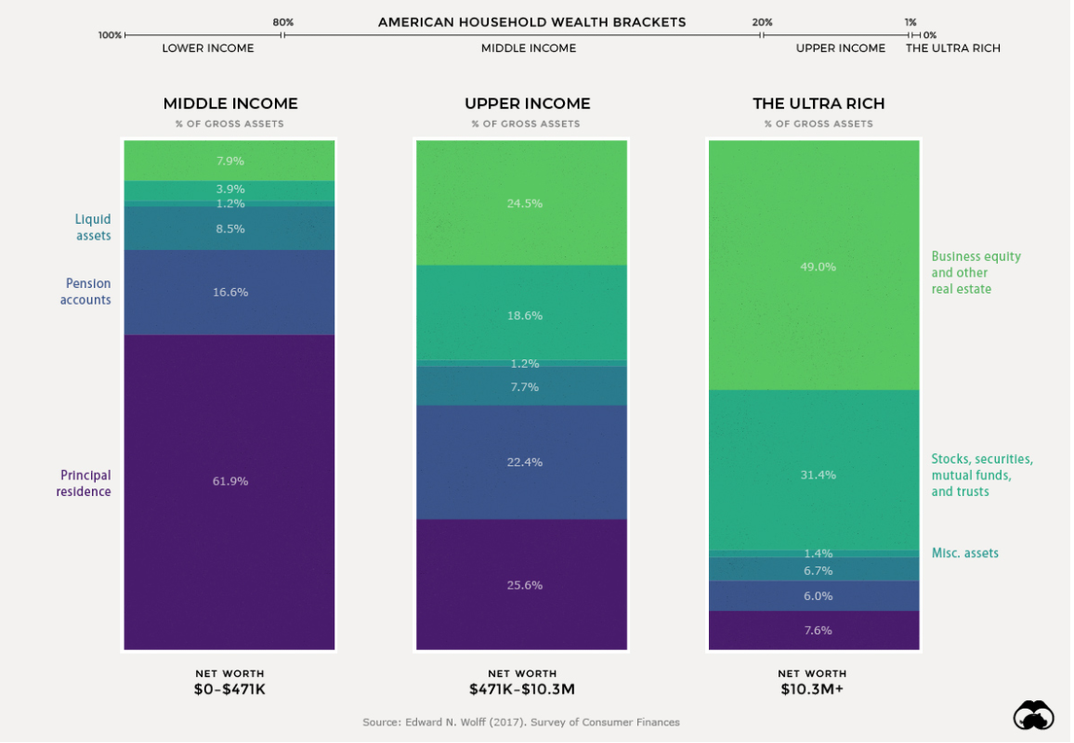

Slide 7
US Millionaire Statistics
In 2021, 2,251,000 new millionaires in US
20.27 million millionaires in the US
13.61 million households have net worth > $1 million
8 million households have net worth > $2 million
1.4 million households have net worth > $10 million
788 Billionaires
80% are self-made millionaires
8% of American adults are millionaires

Slide 8
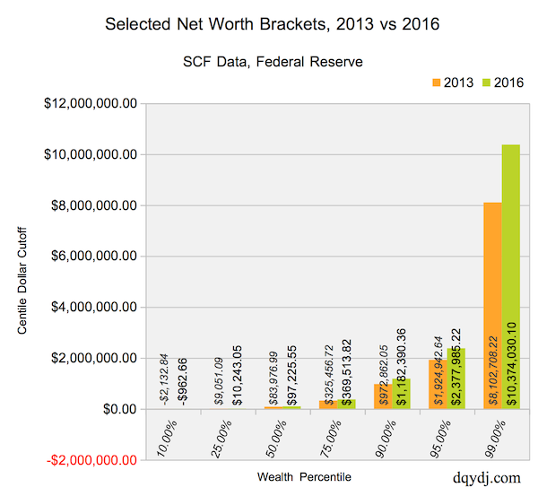

Slide 9
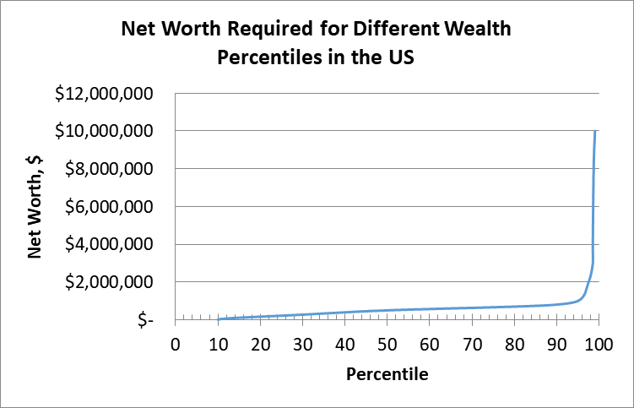
Middle Class Crisis

Slide 10
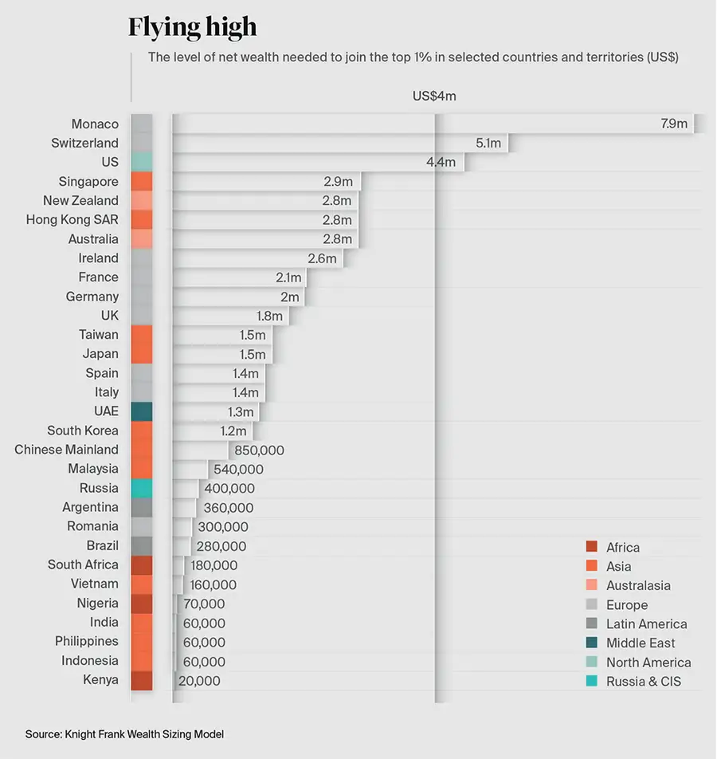
Level of Net Worth to be in Top 1% by Country (2020)
US - $4.4 million
China - $850K
Nigeria - $70K

Slide 11
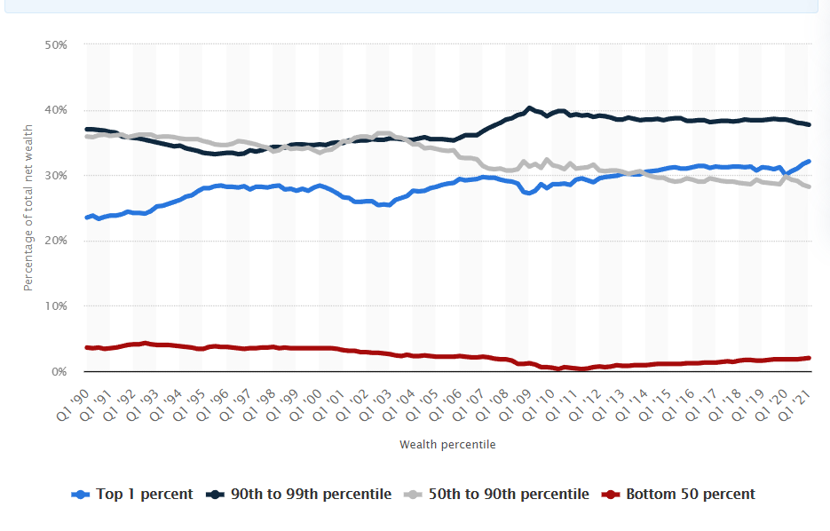
Top 10% Own 70% of US Wealth

Slide 12
How Self-Made Millionaires Got Rich
Some are Self-made, some are born into wealth
Over 2/3 of people worth over $30 million are self-made
Appreciation of investments
Created a company
Compensation and employee stock options
Profit sharing
Set budgets and save!
Source: https://www.businessnewsdaily.com/2871-how-most-millionaires-got-rich.html

Slide 13
What Do Millionaires Do With Their Money?
Investments of Millionaires
Primary residence
Mutual funds
Stocks
Retirement accounts
Real estate
Characteristics of Millionaires
Live on a budget
Prioritize saving over spending
Put their money where it will grow (not depreciate)
Cars lose 20% of value in 1 year (depreciating asset)

Slide 14
Best Way to Become a Millionaire
Set annual financial goals
Avoid debt (cars, credit cards)
Cut unnecessary expenses (comfort items)
Invest early and consistently
Make savings a priority
Invest in different places and avenues (diversity)
Have multiple streams of income (salary, dividends, investments, rental income)
Save, save, save
50/30/20 rule: 50% for needs, 30% for wants and 20% for savings and paying off debt.

Slide 15
Savings Models (Personal Accounts)
Personal savings – bank & brokerage accounts
Stocks
Bonds
Mutual Funds
Interest
Examples of brokerage companies:
Charles Schwab & Sons (selected branch offices)
Fidelity
Vanguard
Edward Jones (local franchised branches)
Robinhood (online only)

Slide 16
Savings Models (Retirement Programs)
*401k – typical corporate retirement program
*403B – voluntary educational retirement program
*457B – deferred compensation program
*Traditional IRA – personal retirement program
Roth IRA – personal retirement program (post-tax $, tax free withdrawal)
*pretax $, taxed on withdrawal as earned income

Slide 17
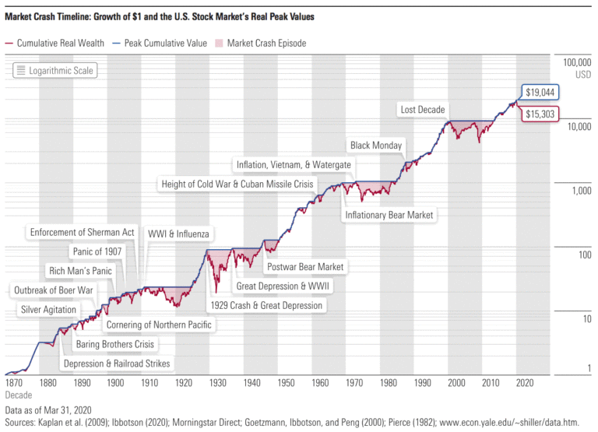
Long Term Stock Market Return is 10% per Year

Slide 18
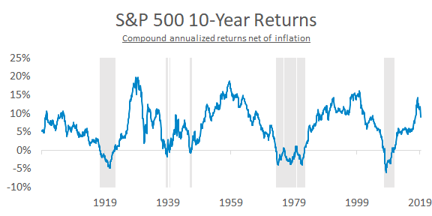

Slide 19
Retirement and Personal Savings Model
V^{t+dt} = V^{t} + (gains – losses) dt
V^{t+dt} = V^{t} + (I*V^{t} + S) dt
Assuming dt = 1 year,
V^{t+dt} = (1+I) V^{t} + S
Where
V = value, $
I = annual interest (decimal rate)
S = annual savings, $
dt = assume one year
Note: Losses = $0 for projection models. There may actually be annual losses in bad market times.

Slide 20
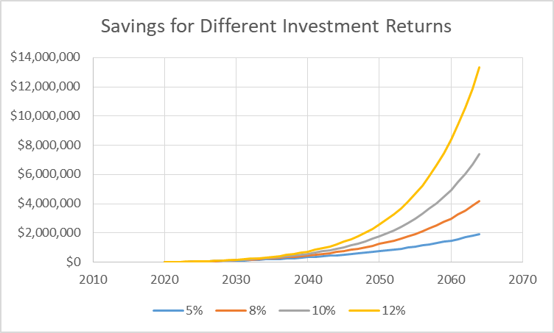
A 23 year old has $50,000 initial salary, annual raise of 3%, savings rate of 15%, 43 years (year 2064). Saves $4.1 million @ 8% return

Slide 21
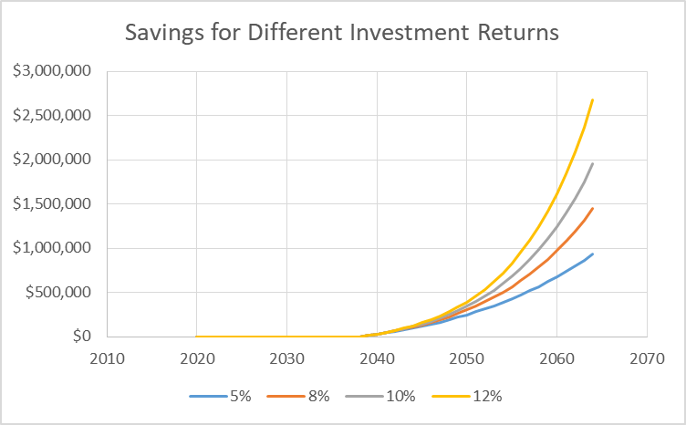
Impact of Delaying Retirement Savings
Delay saving until 40
Pull money from 401k
$1.5 Million @8%

Slide 22
When Does Investment Income = Annual Salary?
It is possible to reach a point where your annual income from investments exceeds your annual income for your job!
Two incomes are better than one!
Annual Return | Age
8 | 54
10 | 47
12 | 42

Slide 23

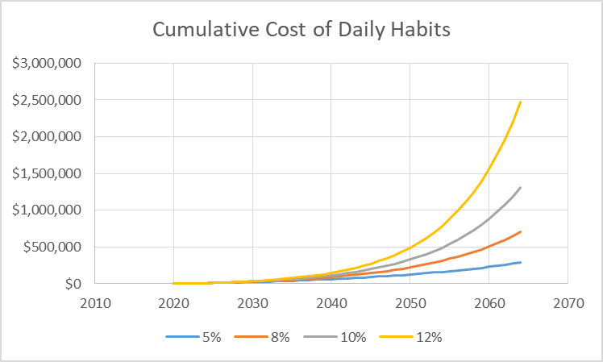
Cost of Daily Habits (Starbucks)
1 Starbucks coffee 5 days/week each year ($7.00)

Slide 24

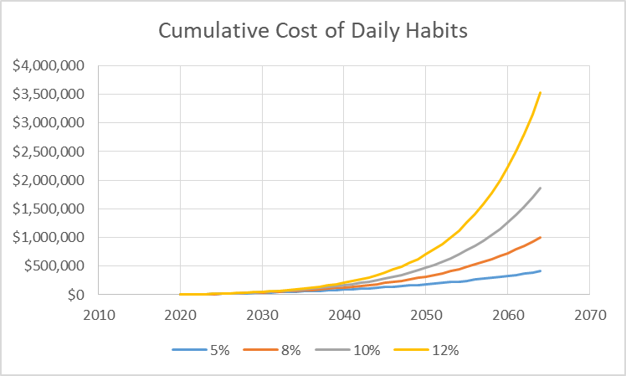

$10 Lunch Costs $1 million in Retirement
1 AU Lunch 5 days/week each year ($10.00)

Slide 25
Borrowing Money
The PMP Function in Excel can be used to compute monthly payments
=PMT(rate,nper,pv)
Rate = interest rate per payment period
NPER = number of payment periods
PV = present value of the loan

Slide 26
Borrowing Money
Example: What is the monthly payment on a $60,000 car financed at 6% over 72 months?
=PMT(.06/12,72,60000) = $994.37
Note that the annual interest rate of 6% must be converted to monthly interest rate by dividing by 12 months since payments are monthly for 72 months.

Slide 27
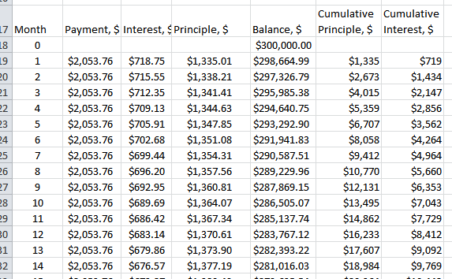
Amortization Schedules
Monthly schedule of loan balance, monthly interest and premium payment

Slide 28
Monthly Mortgage Calculator
Borrow: $300,000
Annual Interest: 2.875%
Duration of Loan: 180 Months
Monthly Payment: $2,053.76
Step 1: Use PMT to compute monthly payments
=PMT(.02875/12,72,300000) = $2053.76

Slide 29
Monthly Payment
Combination of monthly principle and interest
Monthly principle can be computed with the PPMT function
Step 2: Compute monthly principle value of payment
= PPMT (rate, per, nper, -pv)
Rate = interest rate in decimal percent (0.02875)
Per = period to compute principal for (ie. 1, 2, 3,…360)
Nper = total number of payment periods (months) of loan (180)
Pv = Initial (present) value of loan ($300,000)

Slide 30
Monthly Payment
Combination of monthly principle and interest
Monthly interest can be computed with the IPMT function
Step 3: Compute monthly principle value of payment
= IPMT (rate, per, nper, -pv)
Rate = interest rate in decimal percent (0.02875)
Per = period to compute principal for (ie. 1, 2, 3,…360)
Nper = total number of payment periods (months) of loan (180)
Pv = Initial (present) value of loan ($300,000)

Slide 31
Mortgage Example
Borrow: $300,000
Annual Interest: 2.875%
Duration of Loan: 180 Months
Monthly Payment: $2,053.76
Step 4: Update monthly balance state variable
V^{t+dt} = V^{t} + (gains – losses) dt
Gains = $0
Losses = PPMT (rate, per, nper, -pv)
dt = 1 month

Slide 32
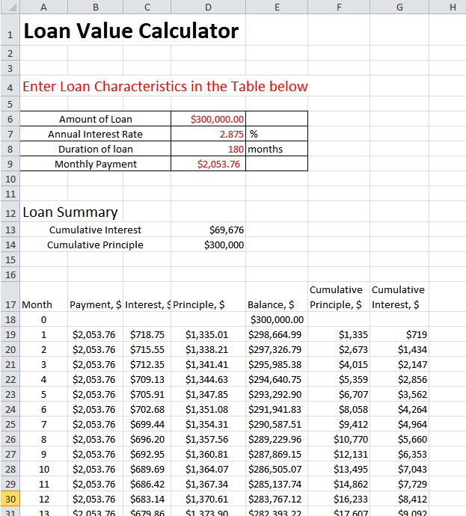
Mortgage Example
Set up Steps 1-4 as columns
This creates Amortization Schedule
Compute cumulative Principle & Interest
Compare cumulative interest vs terms of loan

Slide 33
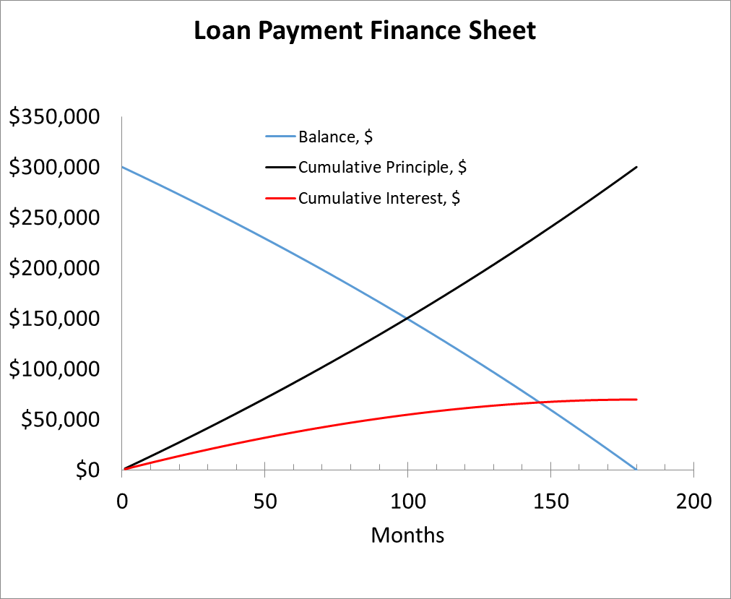
Mortgage Example
Borrow: $300,000
Annual Interest: 2.875%
Duration of Loan: 180 Months
Monthly Payment: $2,053.76
Cum. Interest: $69,676

Slide 34
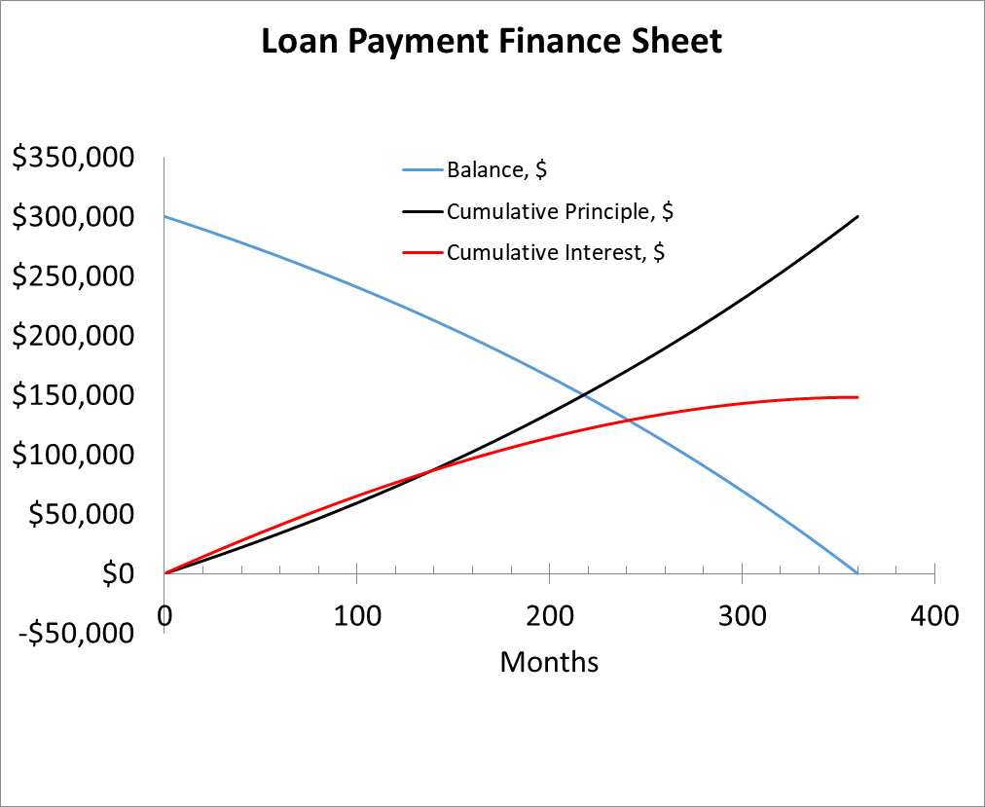
Mortgage Example
Borrow: $300,000
Annual Interest: 2.875%
Duration of Loan: 360 Months
Monthly Payment: $1,244
Cum. Interest: $148,084

Slide 35
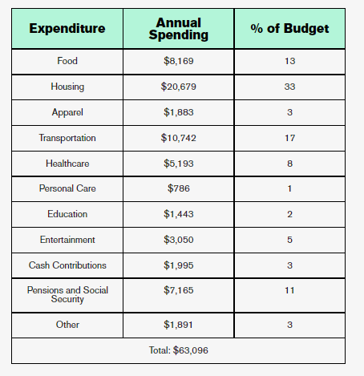
Monthly Struggle
Average Household Budget $63K (2019)
Rent/Mortgage
Car payment
Student loans
Credit cards
Child care
Utilities
Insurance
Savings and investing
Living expenses

Slide 36
Questions?

Slide 37
How Self-Made Millionaires Got Rich
They set ambitious goals and act on them. Self-made millionaires put their ideas and dreams into action, whether that's starting a business or achieving other professional or personal pursuits. This determination is a common driver among many who made their millions without an inheritance.
They have mentors. Many self-made millionaires are quick to admit that they cannot possibly know how to do everything. They reach out to others who know the ins and outs of different types of saving and investing, tapping into the best minds on each subject for perspective and insight. That certainly pays off.
Source: https://www.businessnewsdaily.com/2871-how-most-millionaires-got-rich.html

Slide 38
How Self-Made Millionaires Got Rich
They look for feedback. For a self-made millionaire, self-improvement never stops. Self-made millionaires look for critique and feedback in their ideas and business practices, ensuring that they can better identify blind spots and guarantee that their ventures will succeed.
They are not afraid of failure. Millionaires understand the benefits of learning lessons through failure. However, the risks they take are thoroughly calculated and each scenario played out. Once they commit to something, they give their all.
Source: https://www.businessnewsdaily.com/2871-how-most-millionaires-got-rich.html

Slide 39
How Self-Made Millionaires Got Rich
They understand the value of time. Time is money, and millionaires know this all too well. They quickly learn how to manage their time.
Source: https://www.businessnewsdaily.com/2871-how-most-millionaires-got-rich.html

Slide 40
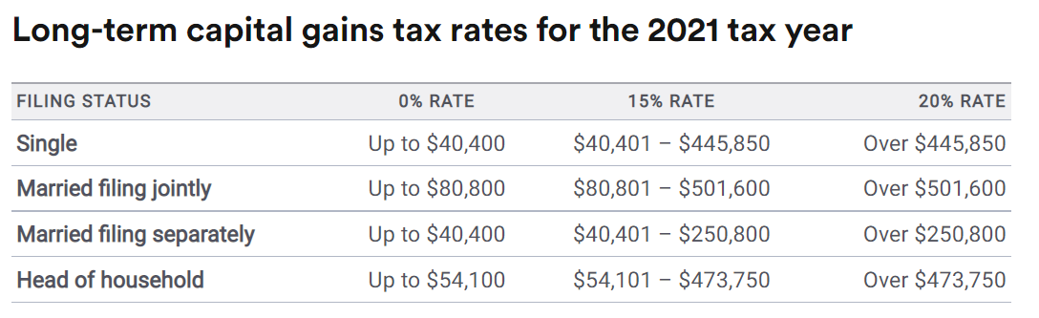
Taxes on Stocks and Mutual Funds
If sold in under 1-year – taxed as regular income (10-37%)
If sold after 1-year, long term capital gains,

Slide 41
Taxes on Retirement Accounts
Taxed as ordinary income
401K
403B
457B
Traditional IRA
Roth IRA’s are after tax dollars invested. Withdrawals are tax free!
Very powerful retirement savings device

